Slide 1

Rockbuster Stealth Data Analysis
June 2022

Slide 2
Project Overview
Goal: Acquire data-driven answers to key business questions for determining 2020 company strategy.
Key Questions:
What was the average rental duration for all videos?
Which movies contributed the most/least to revenue gain?
Which countries are Rockbuster customers based in?
Where are customers with a high lifetime value based?
Do sales figures vary between geographic regions?

Slide 3
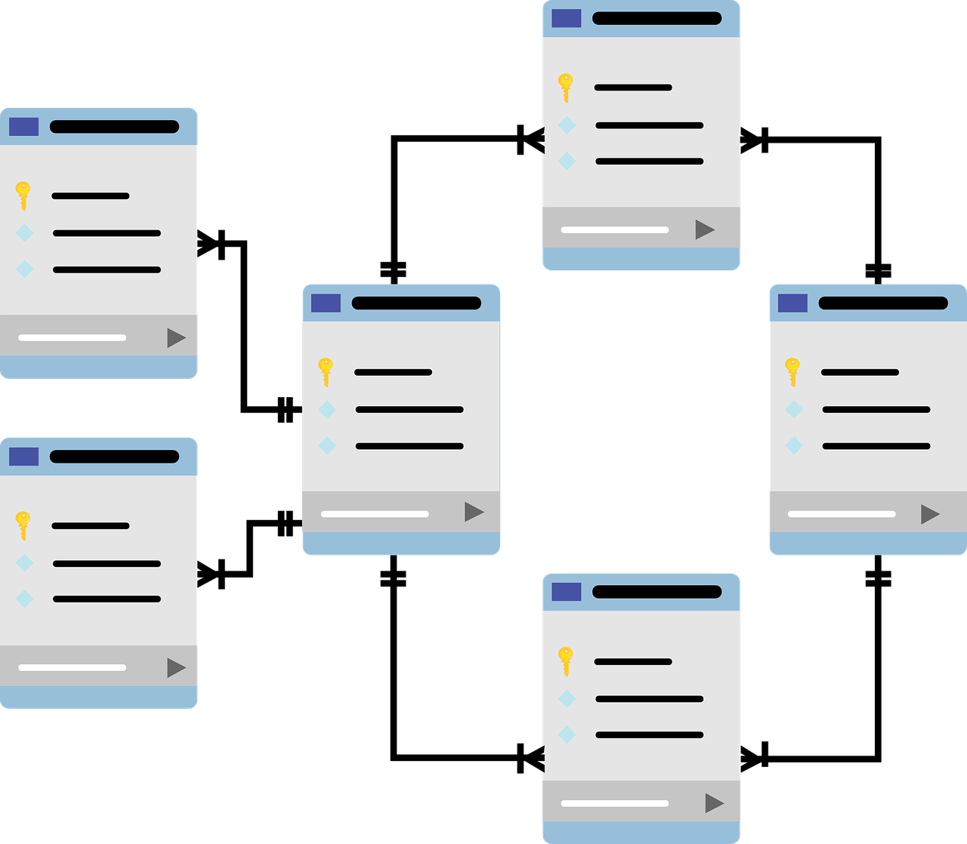
Data Overview
The data is stored in a relational database.
We used SQL to analyze the data and answer key business questions.
All 1000 movies in the database were released in 2006.
English is the only movie language.
PG-13 is the most common movie rating.
Movie Count: 1000 | Release Year: 2006 | Language: English | Modal Movie Rating: PG-13

Slide 4
What was the average rental duration for all videos?
 | Average | Minimum | Maximum
Rental Duration | 5 days | 3 days | 7 days
Movie Length | 115 min | 46 min | 185 min
Rental Price | $2.98 | $0.99 | $4.99
Replacement Cost | $19.98 | $9.99 | $29.99
The average rental duration for all videos was 5 days.

Slide 5
Which movies contributed the most/least to revenue gain?
Top 10 Movies by Revenue
Rank | Movie | Rating | Genre | Revenue
1 | Telegraph Voyage | PG | Music | $215.75
2 | Zorro Ark | NC-17 | Comedy | $199.72
3 | Wife Turn | NC-17 | Documentary | $198.73
4 | Innocent Usual | Pg-13 | Foreign | $191.74
5 | Hustler Party | NC-17 | Comedy | $190.78
6 | Saturday Lambs | G | Sports | $190.74
7 | Titans Jerk | PG | Sci-Fi | $186.73
8 | Harry Idaho | PG-13 | Drama | $177.73
9 | Torque Bound | G | Drama | $169.76
10 | Dogma Family | G | Animation | $168.72
Bottom 10 Movies by Revenue
Rank | Movie | Rating | Genre | Revenue
1 | Texas Watch | NC-17 | Horror | $5.94
2 | Oklahoma Jumanji | PG | New | $5.94
3 | Duffel Apocalypse | G | Documentary | $5.94
4 | Freedom Cleopatra | PG-13 | Comedy | $5.95
5 | Young Language | G | Documentary | $6.93
6 | Rebel Airport | G | Music | $6.93
7 | Cruelty Unforgiven | G | Classics | $6.94
8 | Treatment Jekyll | PG | Drama | $6.94
9 | Lights Deer | R | Classics | $7.93
10 | Stallion Sundance | PG-13 | Sci-Fi | $7.94

Slide 6
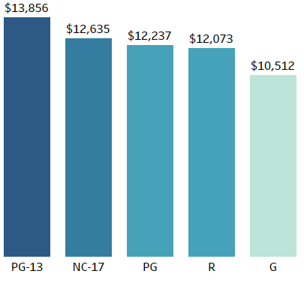
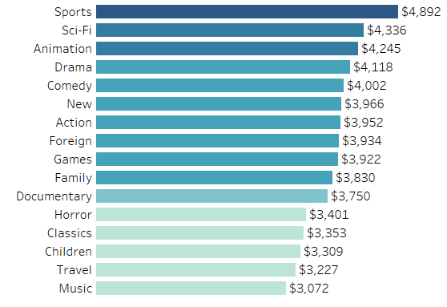
Which movies contributed the most/least to revenue gain?
Revenue by Movie Rating
Revenue by Movie Genre

Slide 7
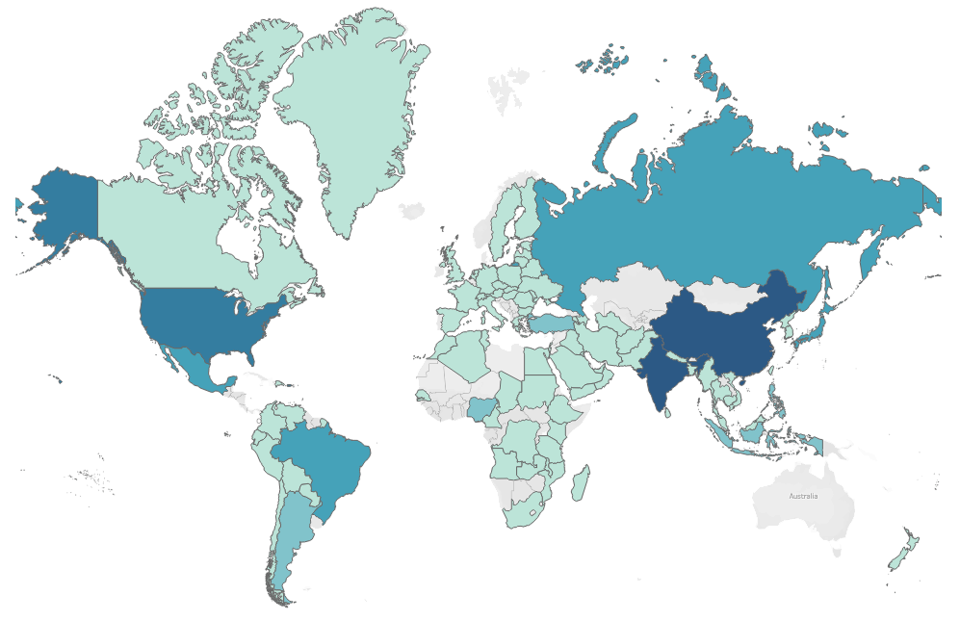
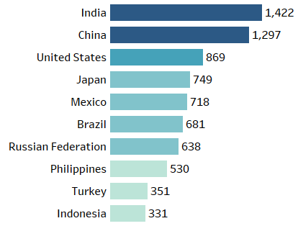

Which countries are Rockbuster customers based in?
Rockbuster Stealth’s customers are located worldwide.
Top 10 Countries by Customer Count

Slide 8
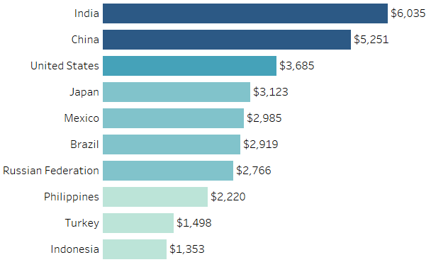
Where are customers with a high lifetime value based?
Top 10 Countries by Customer Spending
India, China, and the United States lead in customer spending. Only five of highest value customers live in the top 10 highest revenue countries.
Top 10 Customers by Individual Spending
Eleanor Hunt | Runion | $212
Karl Seal | United States | $209
Marlon Snyder | Brazil | $195
Rhonda Kennedy | Netherlands | $192
Clara Shaw | Belarus | $190
Tommy Collazo | Iran | $184
Ana Bradley | United States | $168
Curtis Irby | Canada | $168
Marcia Dean | Philippines | $167
Mike Way | India | $163

Slide 9
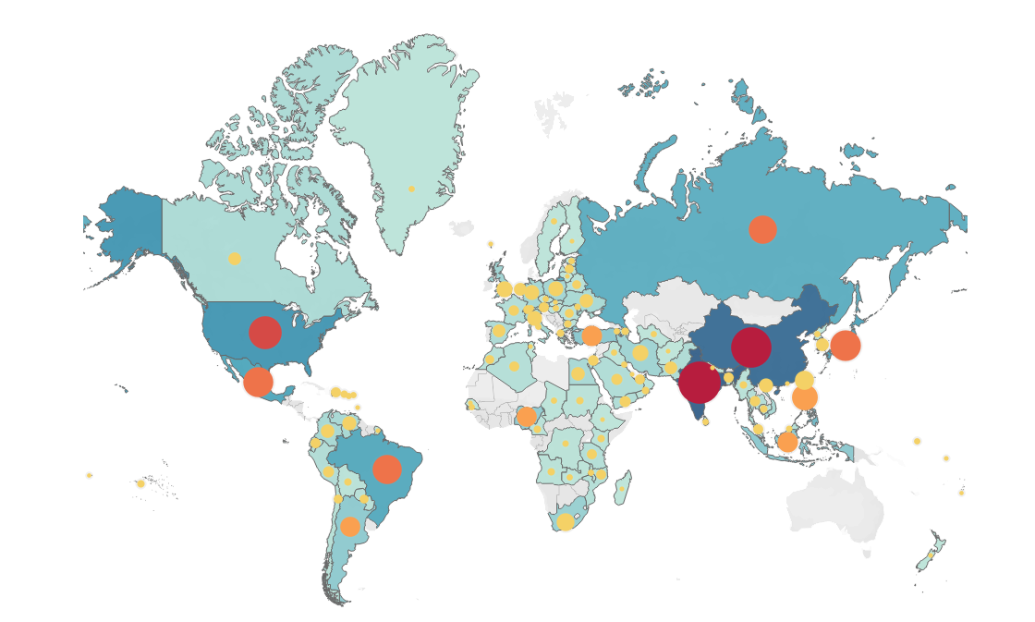
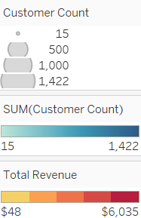
Do sales figures vary between geographic locations?
Sales differ geographically.
Countries with the highest customer counts also have the highest sales.

Slide 10
Insights and Recommendations
Recommendations
Insights
The average rental duration is 5 days.
PG-13 rated movies and movies in the Sports genre contributed the most to revenue gains. G rated movies and movies in the Music genre contributed the least.
Rockbuster’s customers are located wordwide.
Customers with a high lifetime value are also located worldwide.
Sales figure differ geographically with India, China, and the United States being the top performing countries.
Focus spending on movies in the most profitable ratings and genre categories, particularly the PG-13 rating and the Sports, Sci-Fi, and Animation genres.
With the international presence of Rockbuster, expand the movie collection to include movies in the most commonly spoken languages. These languages would include Hindi, Mandarin, and Spanish.

Slide 11
THANK YOU
Data Dictionary, Queries, and Query Outputs are available upon request.
Link to Tableau Visualizations: Rockbuster Stealth

